Slide 1


HOSPITAL PATIENT MANAGMENT SYSTEM
(HPMS)
Group members:
Benachour Mohamed Fouad B1
Saibi Mohamed Abdelilah B1

Slide 2
Outdated systems create inefficiencies that harm patient care and staff productivity:
1/Inefficient Tracking
2/Poor Queue Management ⏱️
PROBLEM ?
3/Error-Prone Processes
4/Disjointed Systems
Hospital Managment
5/No Recovery Mechanism ⚠️

Slide 3

INTRODUCTION
HPMS:
Is A software solution to automate patient workflows in healthcare facilities, replacing error-prone paper systems with an efficient digital platform.

Slide 4

OBJECTIVES
🔧 Core Features
CRUD: Add/View/Update/Delete Patients & Doctors
Search by ID / Name
Assign Doctors & Schedule Appointments
Discharge Patients with Undo
Manage & View Waiting Queues
• Display Hospital Structure
Basic User Authentication

Slide 5

OBJECTIVES
📂 Data Handling
Save/Load Patients, Doctors, Departments
Generate .txt Patient Reports
Pharmacy: Basic Drug Management
•Track Income & Expenses
🖥️ Interfaces
Console Mode: Full Operations
GTK GUI Mode: Basic Functions + Patient Listing

Slide 6
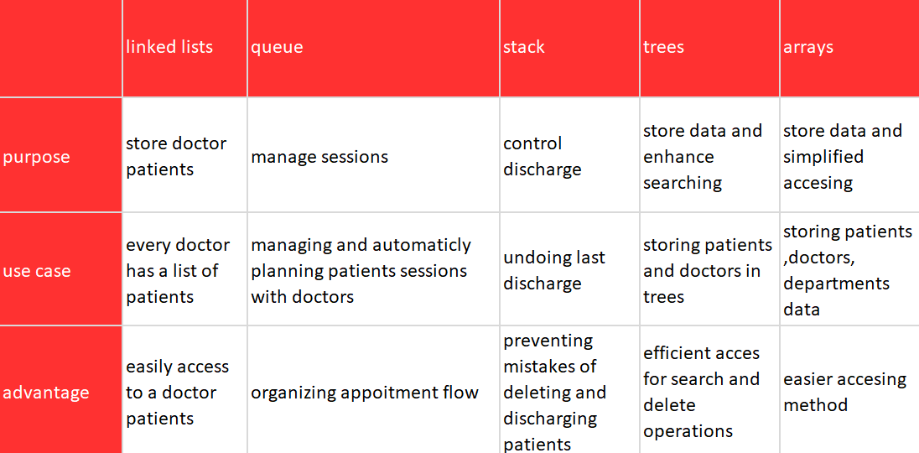

DATA STRUCTURES USED:

Slide 7

FEATURES
HPMS
CRUDS FOR DOC AND PATIENTS
QUEUES MANAGMENT AND AUTO ASSIGMENT
TRACK PATIENTS AND HOSPITAL BALENCE
PHARMACY PROGRAM

Slide 8
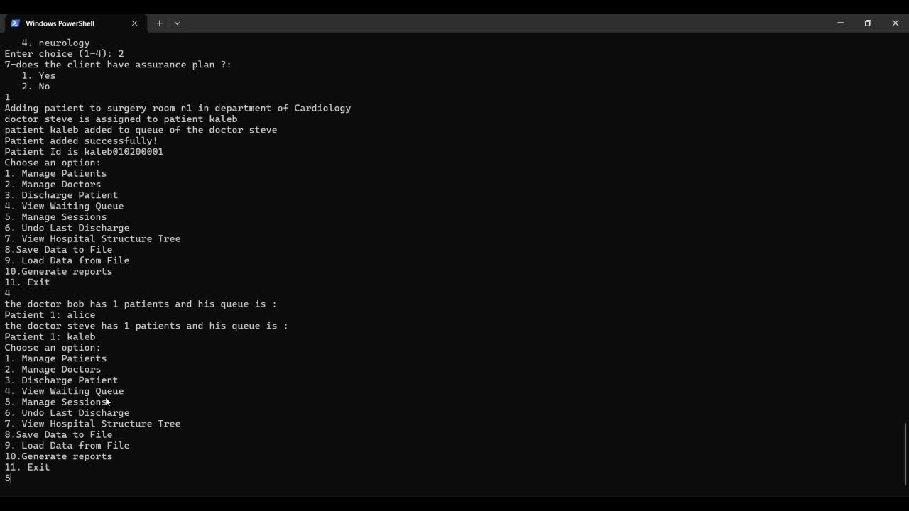
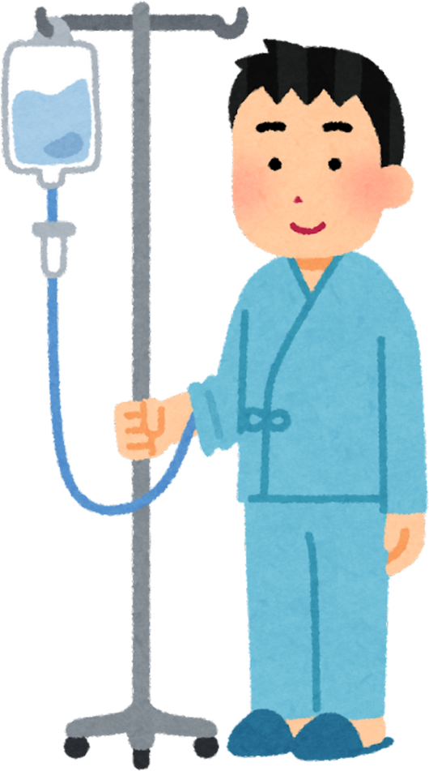
HPMS CONSOLE MODE

Slide 9


HPMS GRAPHIC MODE

Slide 10

Chalenges
Learning Outcomes
Save/Load System
Ensures data integrity when
saving and loading patient
records using file I/O.
Tree Management
Implements balanced trees
for efficient searching and
updating of patient and
department records.
GTK Integration
Bridges console-based logic
with a graphical user
interface (GUI) while
preserving system
performance.
✔ Developed ID-based algorithms for patient/doctor assignment.
✔ Implemented flip-flop concept to auto-balance trees.
✔ Mastered modular design to separate core logic (C) from GUI (GTK).
Impact:
Gained hands-on experience in real world system design and problemsolving

Slide 11
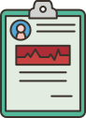
· How can hpms reduce patient wait times?
→ Through automated and dynamic queue management.
· How can staff avoid losing critical patient data?
→ By save/load option.
· How can hpms effectively track and manage the distribution of prescribed medications ?
→ By providing a pharmacy system that has client side that permits the dynamic transaction and usage of medicines with delivery services.
Q/A

Slide 12

THANK YOU!

